Slide 1
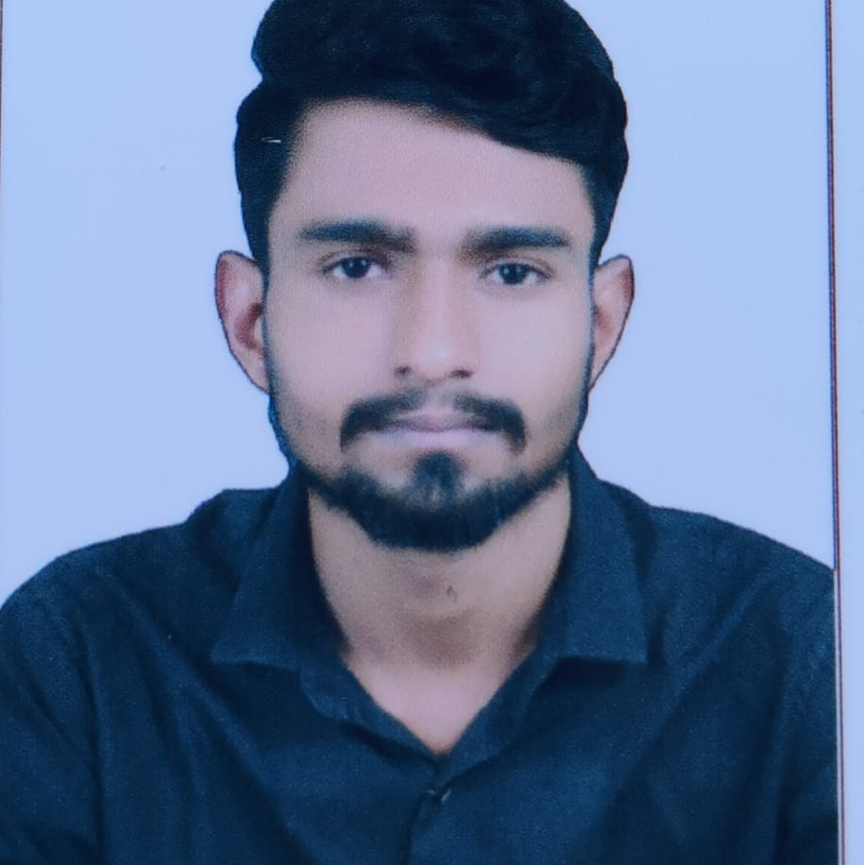

Gandla Madan Mohan
Analyst/Software Engineer
Bachelor of Technology
Electrical and Electronics Engineering: 2017 - 2021
Skills C#
Python
Database
SQL database – MSSQL
Backend
Web API
Add-ons
GitHub
Postman
Additional Details
Leadership
Good Listener
Team management
Quick Learner
Bangalore
gandla.madan.mohan@capgemini.com
+91 8008360969
A4
Ready to learn new technologies and implement them to further improve my knowledge
A team player with good communication skill always ready to work for the enrichment of knowledge
Eager to work in a team of dedicated people and serve a key role in the enhancement and development of the project.
GIG MANAGEMENT SYSTEM
Completed end to end case study of Employee Management System, Postman and swagger Testing Html CSS used for user interface.
Az-900 Certification from Microsoft
Completed this course and having Azure certification

